Slide 1
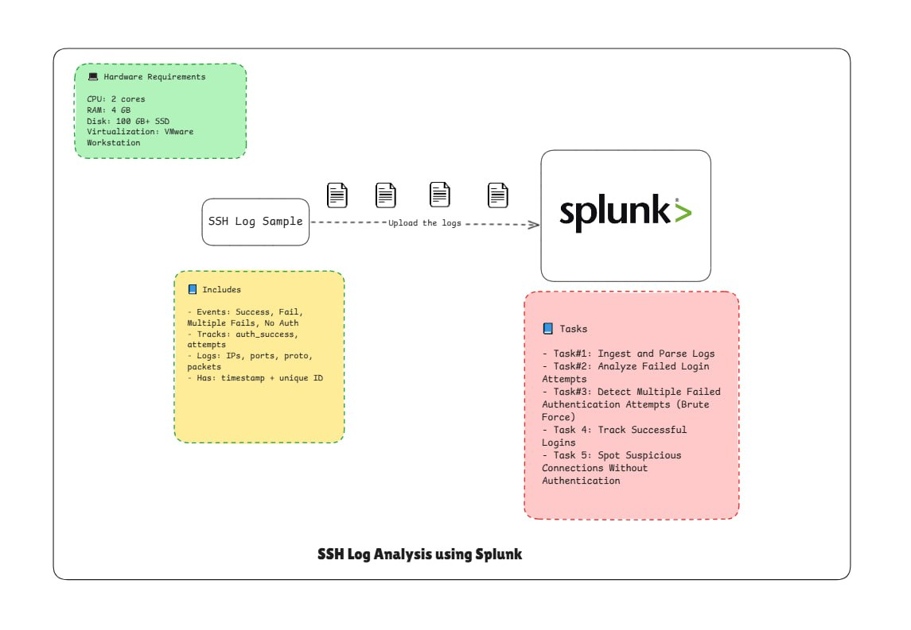
Project: SSH Log Analysis using Splunk

Slide 2
Objective
The goal of this project is to analyze SSH authentication logs to detect:
Successful logins (who connected, from where)
Failed login attempts (possible brute-force or password spraying)
Multiple failed authentication attempts (indicators of brute-force)
Connections without authentication (potential scanning or incomplete sessions)
By completing this project, you’ll learn how to use Splunk to ingest SSH logs, run queries, create dashboards, and generate alerts.

Slide 3
Lab Setup and Pre-requisite
Complete the Splunk Installation Project
Download the SSH Log File
Preparation
Log in to your Splunk instance (Enterprise or Free).
Go to Apps > Search & Reporting.
Click Add Data → Upload.
Select the provided ssh_log.json file and upload it.
Choose sourcetype = _json so Splunk automatically extracts fields.
Index it under a new index, e.g., ssh_logs.
Review and click on start searching

Slide 4
Task 1: Ingest and Parse Logs
Upload ssh_log.json into Splunk.
Ensure the following fields are extracted correctly:
  event_type (Successful SSH Login, Failed SSH Login, Multiple Failed Authentication Attempts, Connection Without Authentication)
  auth_success (true/false/null)
  auth_attempts
  id.orig_h (source IP)
  id.resp_h (destination host)
Run a validation search:
→index=ssh_log | stats count by event_type

Slide 5
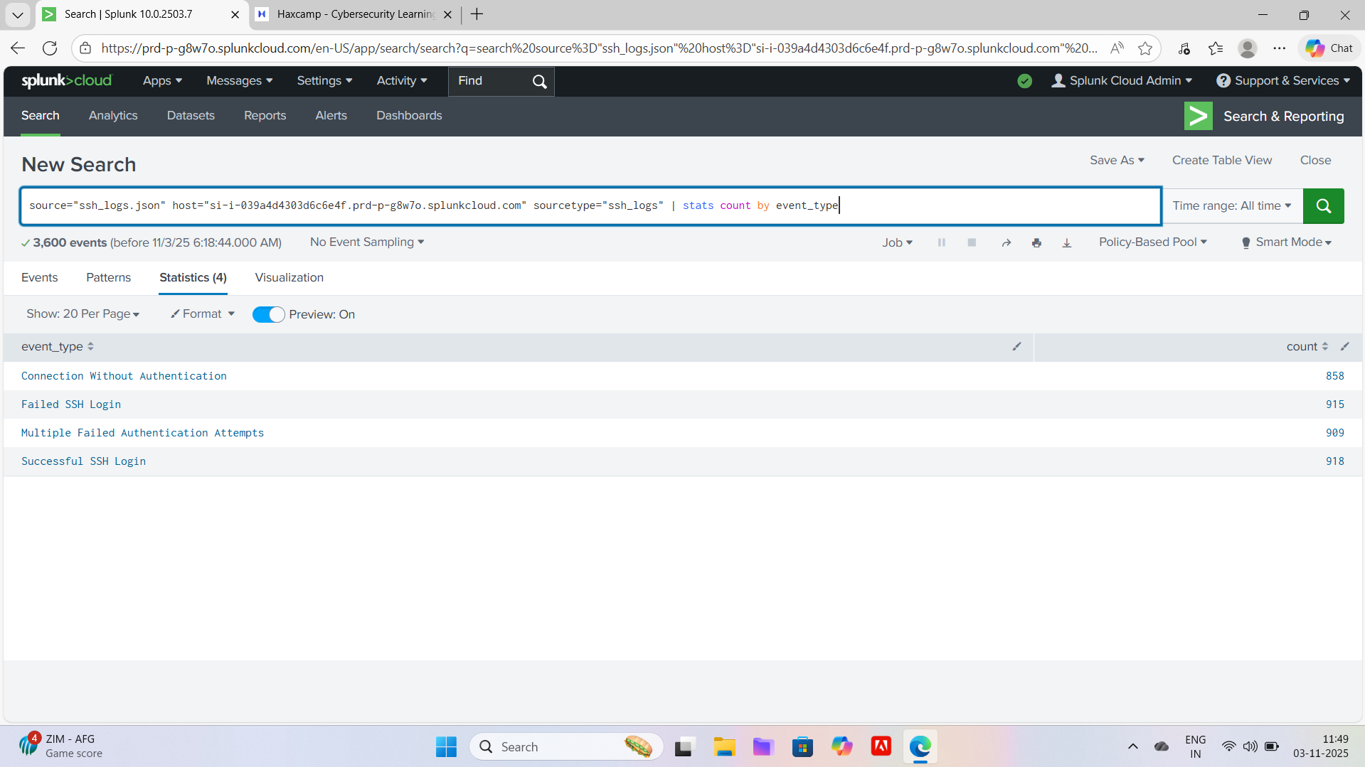

Slide 6
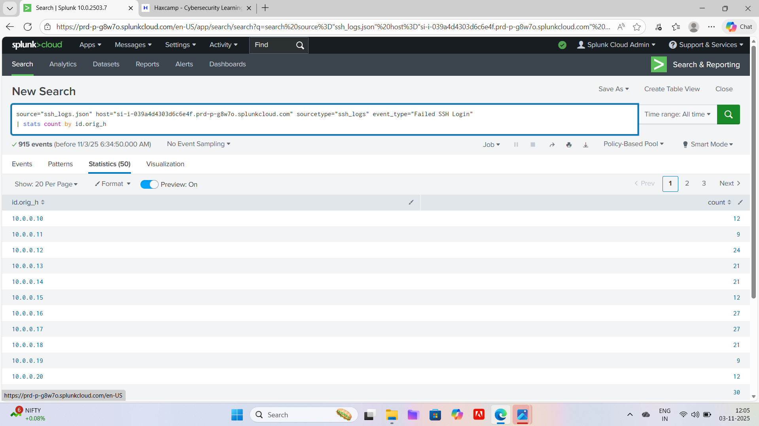
Task 2: Analyze Failed Login Attempts
Identify all failed login attempts:
index=ssh_logs event_type="Failed SSH Login"
| stats count by id.orig_h
Highlight the top 10 source IPs generating failed logins.

Slide 7
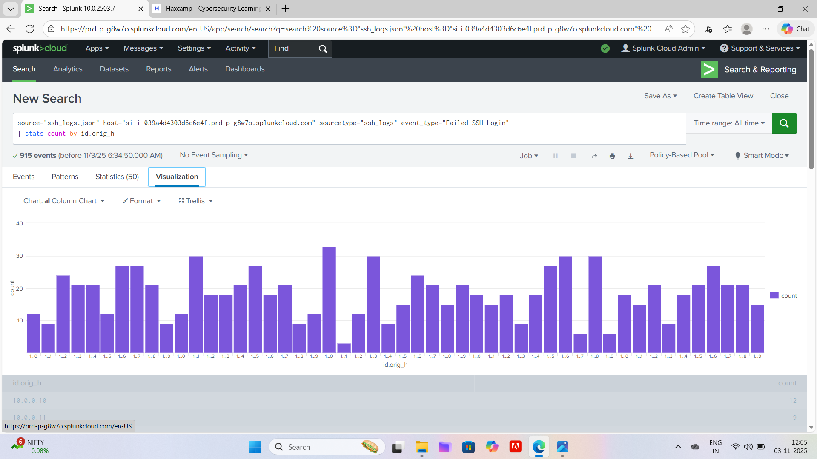
Create a bar chart visualization for failed login attempts per source IP.

Slide 8
Task 3: Detect Multiple Failed Authentication Attempts (Brute Force)
Search for multiple failed attempts in logs:
index=ssh_logs event_type="Multiple Failed Authentication Attempts"
| stats count by id.orig_h, id.resp_h
Detect repeated failures (e.g., more than 5 attempts).

Slide 9
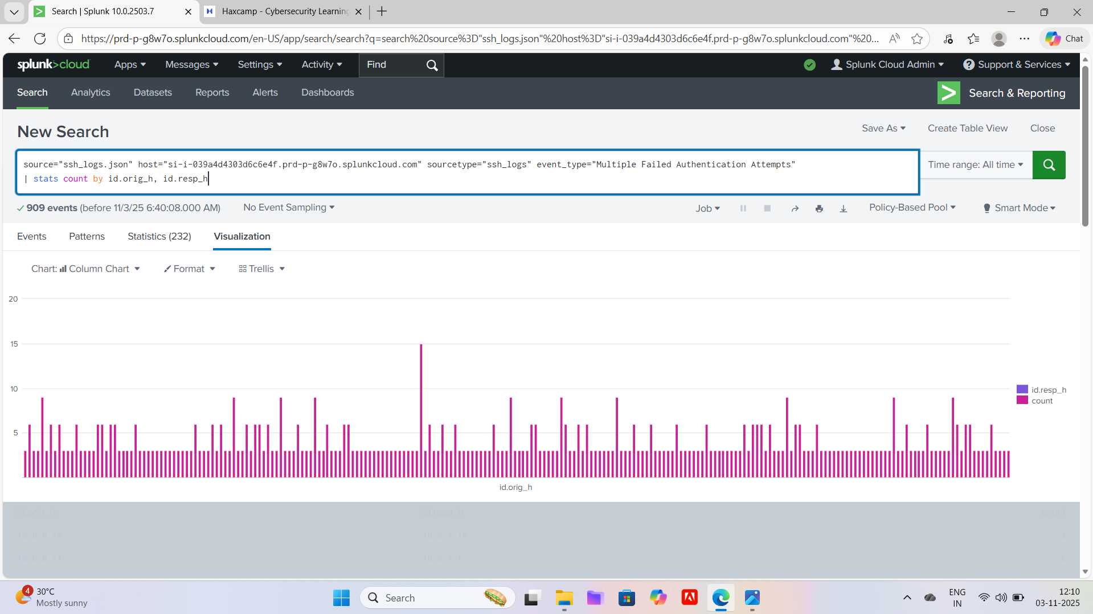
Multiple Failed Authentication Attempts (Brute Force)

Slide 10
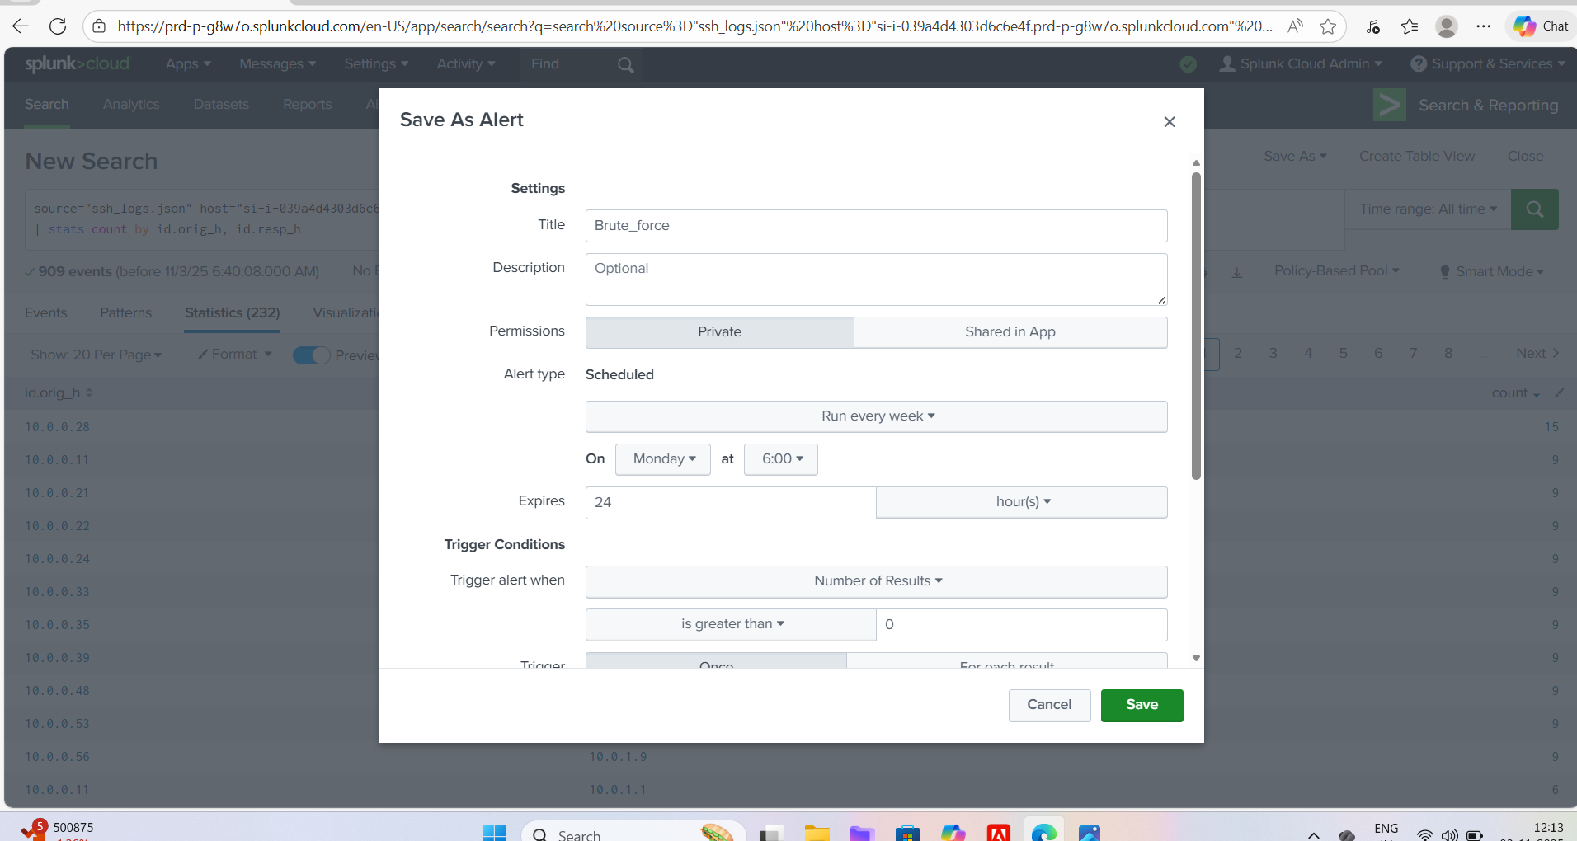
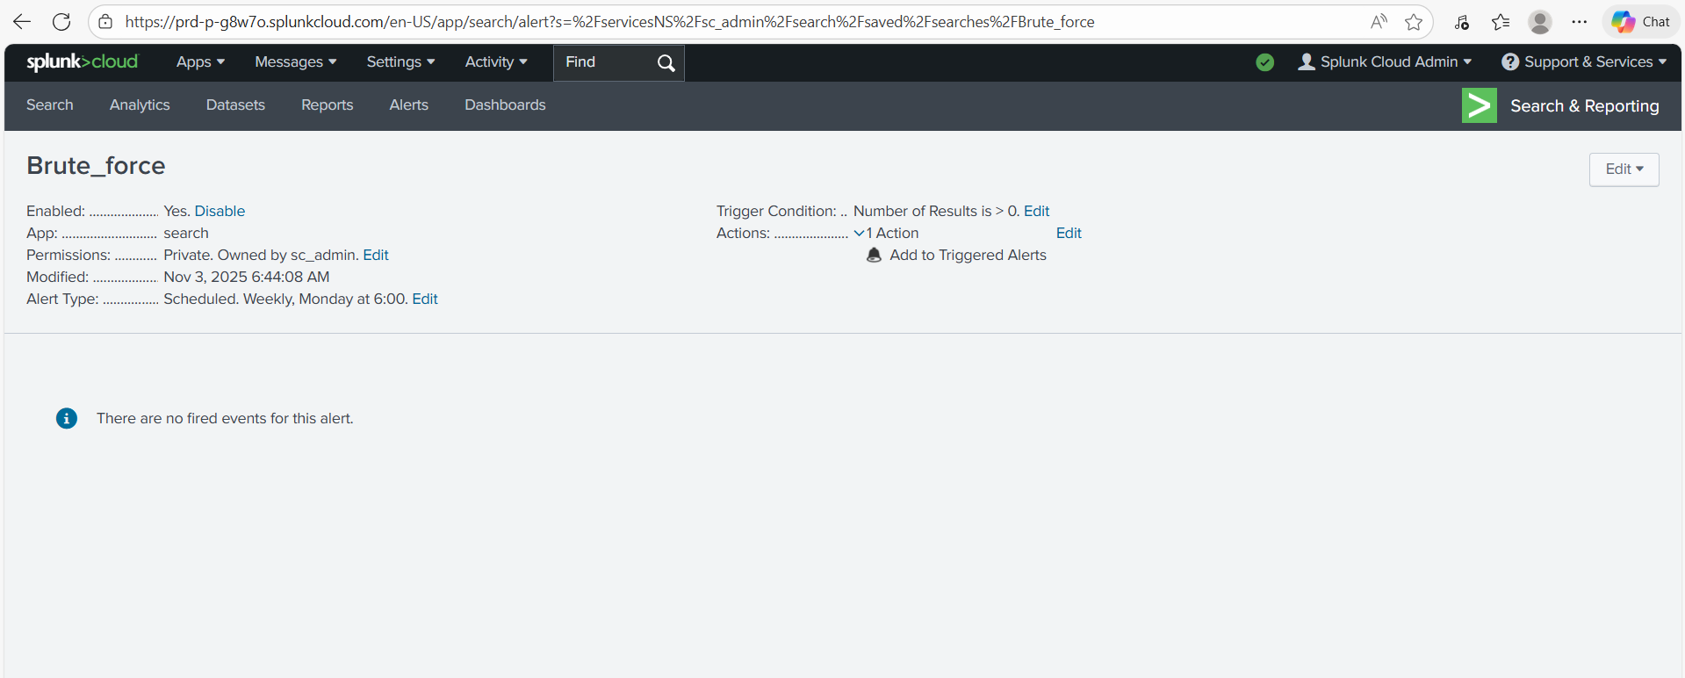
Configure a Splunk alert:
Trigger when any IP attempts more than 5 logins within 10 minutes.

Slide 11
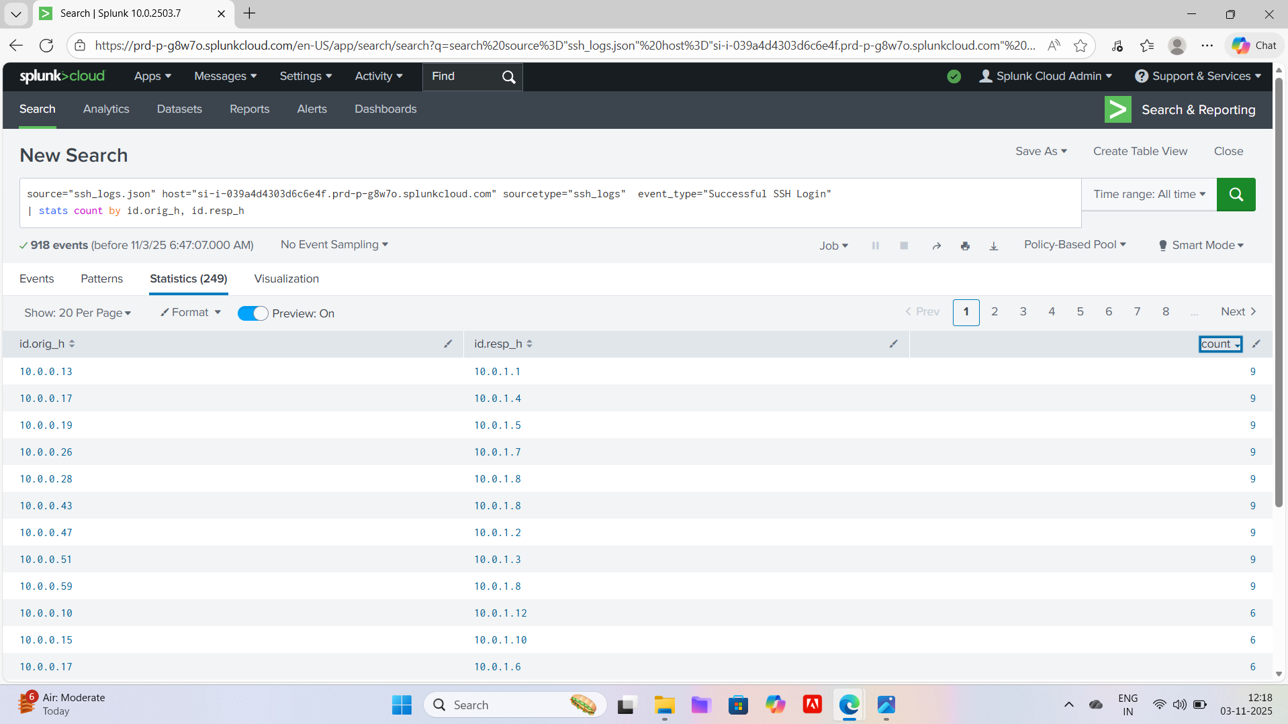
Task 4: Track Successful Logins
Search for unauthenticated SSH connections:
index=ssh_logs event_type="Connection Without Authentication"
| stats count by id.orig_h
Compare successful logins against prior failed attempts (to detect compromised accounts).
Create a dashboard panel showing top source IPs for successful logins.

Slide 12
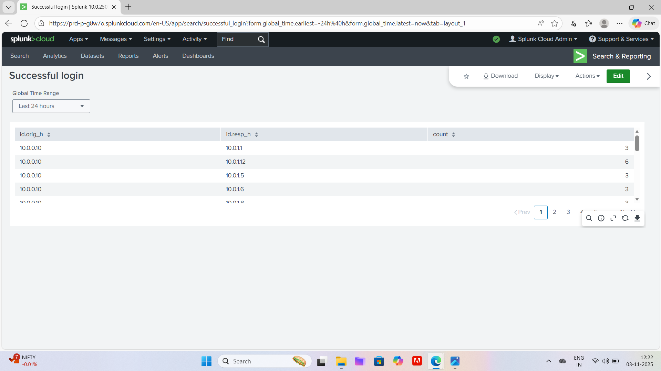
Compare successful logins against prior failed attempts (to detect compromised accounts).
Create a dashboard panel showing top source IPs for successful logins.

Slide 13
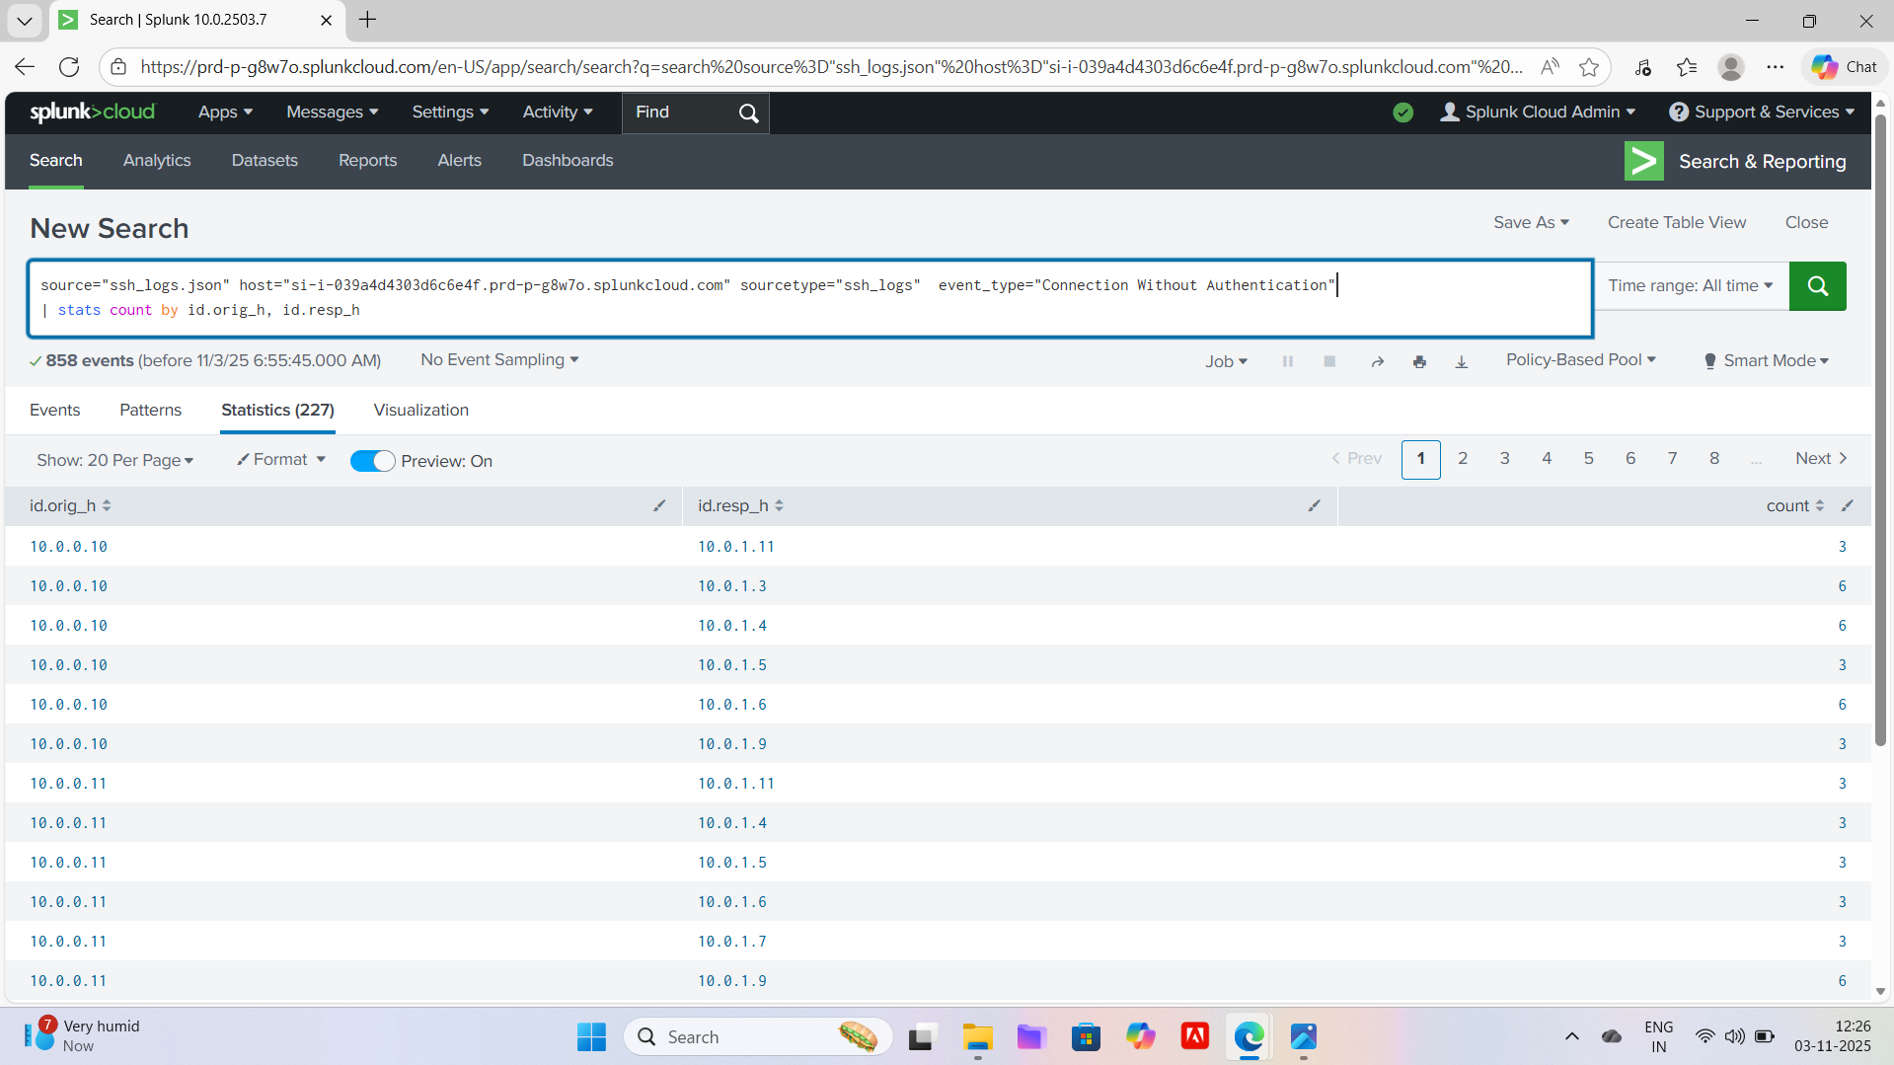
Task 5: Spot Suspicious Connections Without Authentication
Search for unauthenticated SSH connections:
index=ssh_logs event_type="Connection Without Authentication"
| stats count by id.orig_h

Slide 14
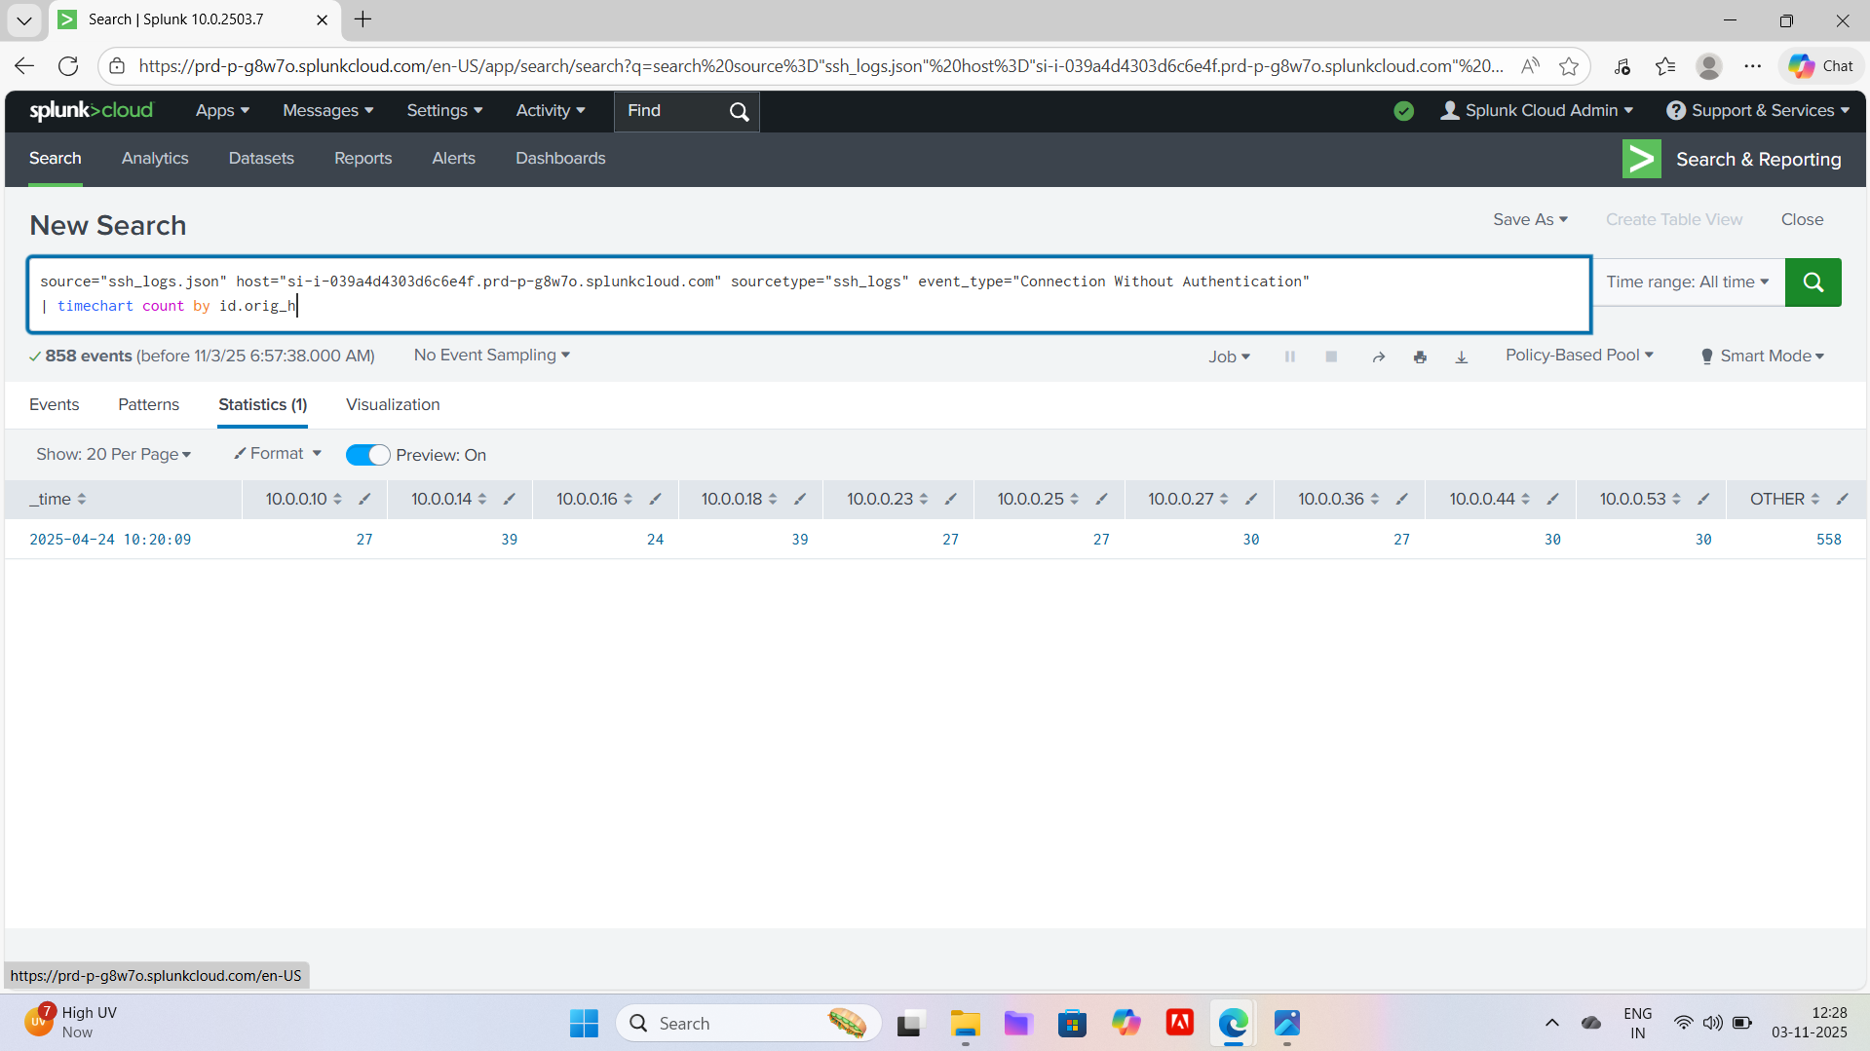
Create a timechart visualization to monitor such events over time:
index=ssh_logs event_type="Connection Without Authentication"
| timechart count by id.orig_h
Identify repeated unauthenticated attempts — potential indicators of port scanning or SSH probing.

Slide 15
-------------------Conclusion-----------------------
Built dashboards to monitor SSH activity.
Identified brute-force login attempts and suspicious access attempts.
Configured Splunk alerts for high-risk behavior.
Learned how to parse, search, visualize, and alert on SSH logs in Splunk.
This project provides practical SOC Analyst–level log analysis skills and strengthens your cybersecurity portfolio.

